Slide 1
Command Pattern

Slide 2
Command Pattern
Command is a behavioral design pattern:
  Turns a request into a stand-alone object that contains all information about the request.
This transformation lets you:
  parameterize different sets of requests,
  delay or queue a request’s execution, and
  support undoable operations.

Slide 3
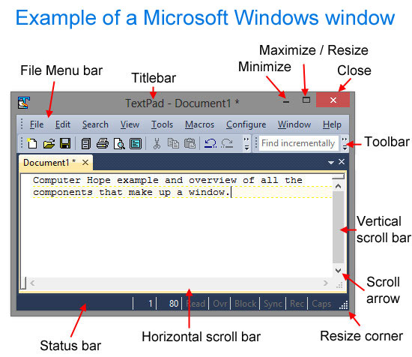
Introduction
Sometimes a class needs to perform actions without knowing what the actions are…
Example:
  A GUI toolkit provides several components: Buttons, scroll bars, text boxes, menus, etc.
Toolkit components only know apriori know how to draw themselves on the screen:
  But they don't know how to perform application logic
Application developers need a way to associate required application logic with GUI components
  What should happen when a button is pressed?
  What should happen when a menu item is selected?

Slide 4
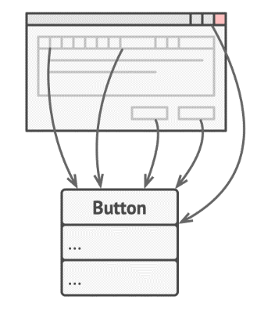
Motivation
Suppose you’re working on a new text-editor app.
You created a very neat Button class:
  To be used as generic buttons in various dialogs.

Slide 5
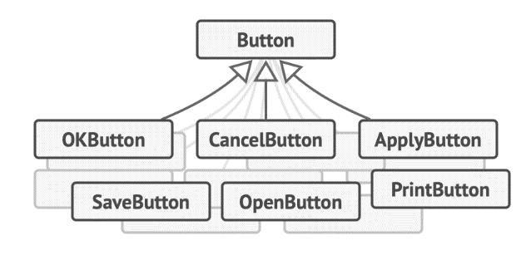
First-Cut Design
Generic buttons won’t do much:
  But, each button needs to carry out separate actions.
You toyed with the idea of creating hundreds of sub-classes of the button class.

Slide 6
First-Cut Design --- Cons
You have an enormous number of subclasses --- Poses Maintenance issues
You break the design each time you modify a base class
You may have different methods for invoking the same command, e.g hot keys
  Either duplicate code or make hot-keys dependent on buttons

Slide 7
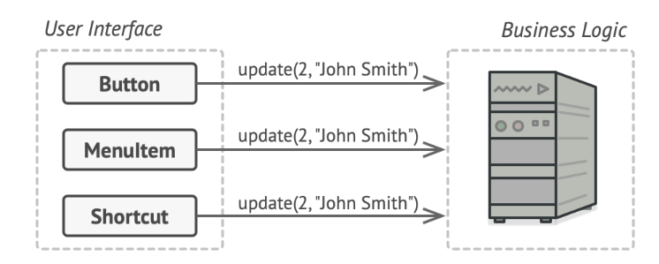
Refined Design
GUI object calls a method of a business logic object, passing it some arguments.

Slide 8
Analysis of the Design
Unnecessary Duplication of Code
GUI directly interacts with the Entity classes --- Need a middleware
Command pattern solution:
  Put name of the method name and arguments into a separate Command class,

Slide 9
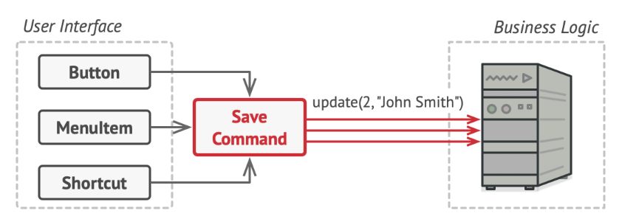
Next Refinement
Middleware! can be handy
We now can recognize that all commands need to implement the same interface…

Slide 10
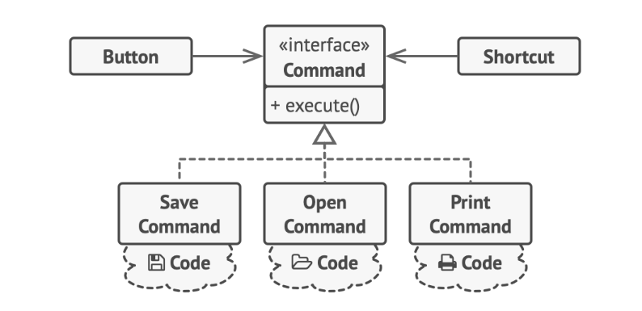
Command Pattern: GUI Objects Delegate Work to Command Objects

Slide 11
Button Example: Solution
Implement a bunch of command classes for every possible operation:
  Link them with particular buttons, depending on the buttons’ intended behavior
Commands become a convenient middle layer:
  Reduces coupling between the GUI and business logic layers.
  And that’s only a fraction of the benefits that the Command pattern can offer!

Slide 12
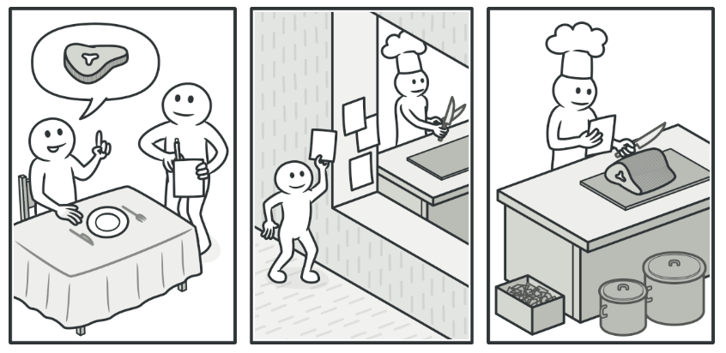
Real World Example

Slide 13
Command Pattern: Intent
Encapsulate a request from the client as an object, thereby
  Parameterize requests,
  Queue or log requests, and
  Support undoable operations

Slide 14
When to use Command?
Command Pattern is useful when:
  A history of requests is needed
  You need callback functionality
  Requests need to be handled at variant times or in variant orders
  The invoker should be decoupled from the object handling the invocation

Slide 15
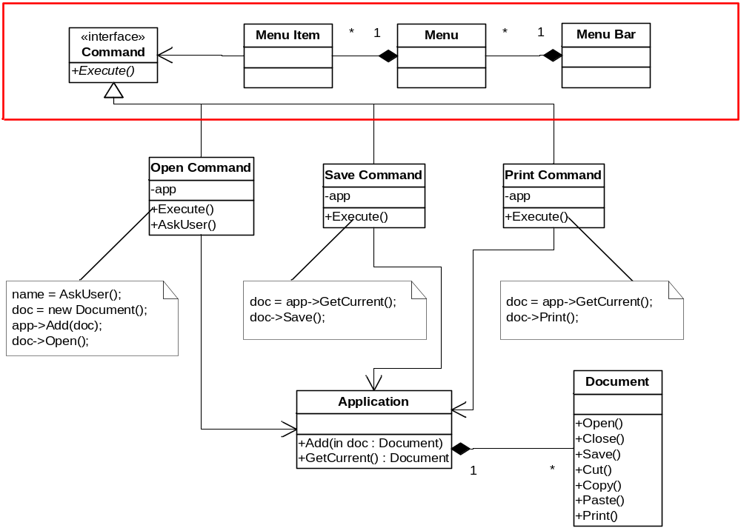
Example: GUI Toolkit

Slide 16
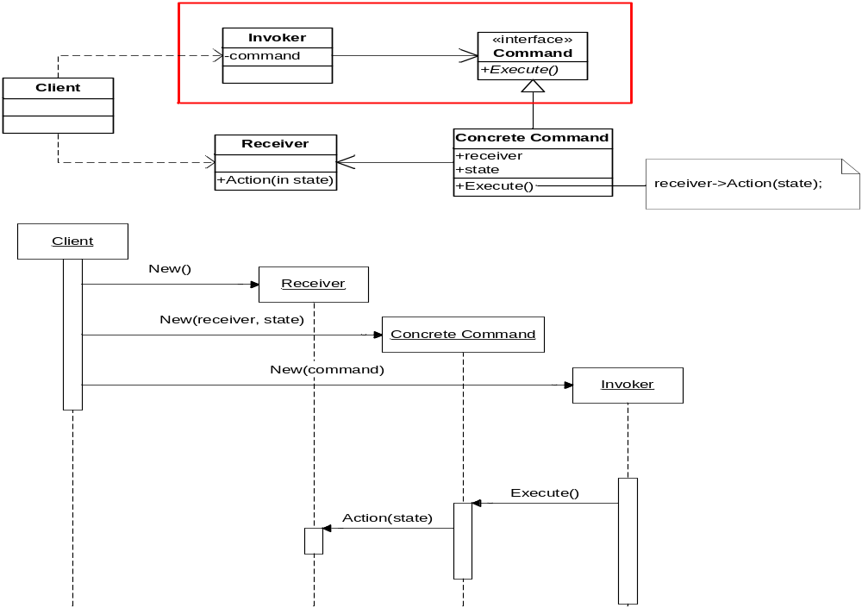
Example: GUI Toolkit

Slide 17
Other Applications of Command
Support Undo:
  It’s difficult to undo effects of an arbitrary method as Methods vary over time.
What are some applications that need to support undo?
  Editor, calculator, database with transactions. etc
Support Redo:
  Similar complex issues

Slide 18
Structure of command pattern
1
Invoker stores commands and asks ConcreteCommand objects to perform action
Client
Invoker
Command
Execute()
1
receiver
Receiver
ConcreteCommand
Action()
Receiver.Action()
execute()
State

Slide 19
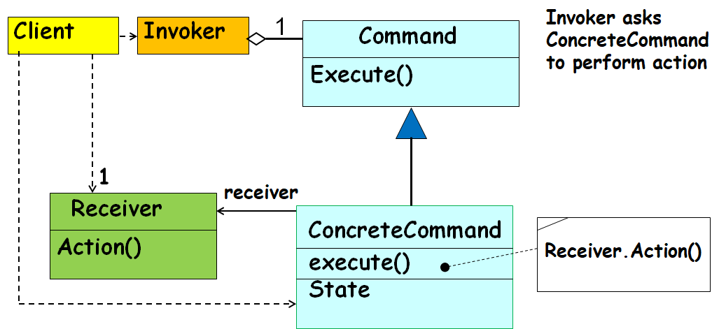
Command pattern: Participants
Command (Command) declares an interface for executing an operation
ConcreteCommand defines a binding between a Receiver object and an action
  implements Execute by invoking the corresponding operation(s) on Receiver
Invoker asks the command to carry out the request
Receiver knows how to perform operations associated with carrying out the request
Client creates a ConcreteCommand object and sets its receiver

Slide 20
Command pattern: Operation
Client creates a ConcreteCommand object and specifies its receiver.
An Invoker object stores the ConcreteCommand object
The invoker issues a request by calling Execute on the command.
When commands are undoable, ConcreteCommand stores state for undoing before invoking Execute
ConcreteCommand object invokes operations on its receiver to carry out request

Slide 21
Sequence Diagram
:aClient
aReceiver
anInvoker
aCommand
<<new >>
<<new >>
<<new>>
StoreCommand(aCommand)
Execute()
Action()

Slide 22
Consequences
Completely decouples objects from the actions they execute
Objects can be parameterized with arbitrary actions
Adding new kinds of actions is easy
  Just create a new class that implements the Command interface

Slide 23
Known Uses: Undo/Redo
Store a list of actions performed by the user
Each action has
  A “do” method that knows how to perform the action
  An “undo” method that knows how to reverse the action
Store a pointer to the most recent action performed by the user
Undo – “undo” the current action and back up the pointer
Redo – move the pointer forward and “redo” the current action

Slide 24
Exercise 1
Assume that you can place on a trading platform (also called a broker) a set of buy ands sell order on specific stocks.
The broker deals with a large number of stocks.
It will place either buy or sell order for specific stocks as you might have specified.

Slide 25
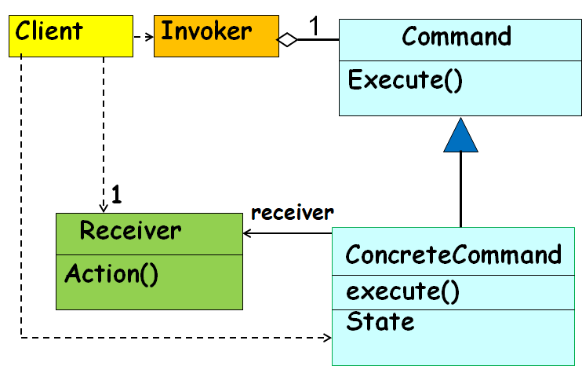
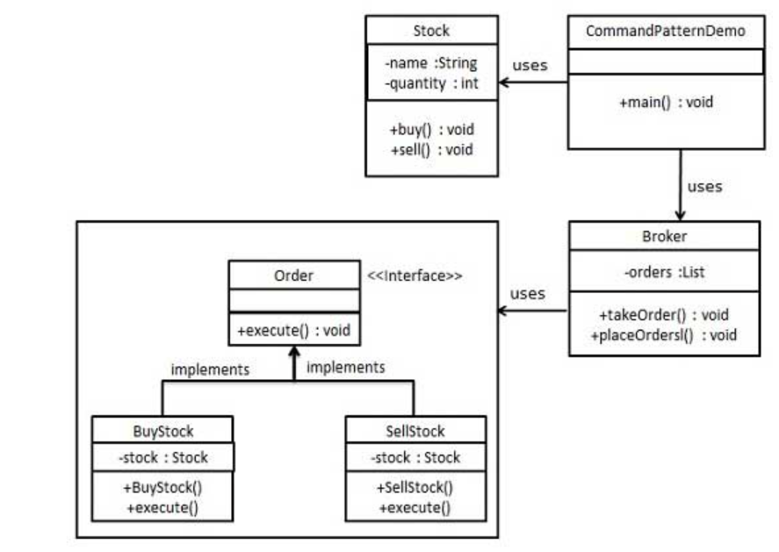
Exercise 1: Solution
Receiver
Command
Invoker

Slide 26
Players in the Design
interface Order which is acting as a command.
Stock class acts as a request.
Concrete command classes BuyStock and SellStock implementing Order interface which will do actual command processing.
A class Broker is created which acts as an invoker object.
  It can take and place orders.

Slide 27
Implementation
public class Stock { //Receiver
private String name = "ABC";
private int quantity = 10;
public void buy(){
System.out.println("Stock [ Name: "+name+",
Quantity: " + quantity +" ] bought");
}
public void sell(){
System.out.println("Stock [ Name: "+name+",
Quantity: " + quantity +" ] sold");
}
}

Slide 28
public class BuyStock implements Order {
private Stock abcStock;
public BuyStock(Stock abcStock){
this.abcStock = abcStock;
}
public void execute() {
abcStock.buy();
}
}
public interface Order {
void execute();
}
Public class SellStock implements Order {
private Stock abcStock;
public SellStock(Stock abcStock){
this.abcStock = abcStock;
}
public void execute() {
abcStock.sell();
}
}

Slide 29
import java.util.ArrayList;
import java.util.List;
public class Broker {
private List<Order> orderList = new ArrayList<Order>();
public void takeOrder(Order order){
orderList.add(order);
}
public void placeOrders(){
for (Order order : orderList) {
order.execute();
}
orderList.clear();
}
}

Slide 30
public class CommandPatternDemo {
public static void main(String[] args) {
Stock abcStock = new Stock();
BuyStock buyStockOrder = new BuyStock(abcStock);
SellStock sellStockOrder = new SellStock(abcStock);
Broker broker = new Broker();
broker.takeOrder(buyStockOrder);
broker.takeOrder(sellStockOrder);
broker.placeOrders();
}
}

Slide 31
Exercise
Design and Build a remote that will control variety of home devices
  Add an “undo” button to support one undo operation
Sample devices: lights, stereo, TV, ceiling light, thermostat, sprinkler, hot tub, garden light, ceiling fan, garage door

Slide 32
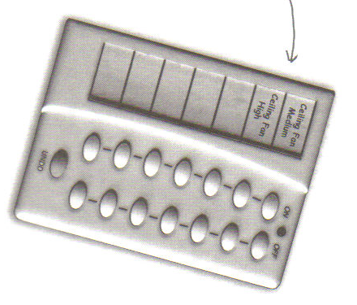
Command pattern – Undo operation

Slide 33
Command Pattern Class Diagram for Home automation
RemoteControl
RemoteLoader
onCommands
offCommands
setCommand()
onButtonPushed()
offButtonPushed()
<<Interface>>
Command
execute()
undo()
Light
LightOnCommand
on()
off()
LightOffCommand
execute()
undo()
execute()
undo()

Slide 34
Public interface Command{
Public void execute();
}
Public class SwitchOnCommand implements Command{
Switch switch;
public LightOnCommand(Switch switch){
this.switch = switch; }
public void execute(){ switch.on(); }
}

Slide 35
Public class RemoteControlTest{
Public static void main(String[] args){
RemoteControl remote=new RemoteControl();
GarageDoor garageDoor = new GarageDoor();
GarageDoorOpenCommand = new
GarageDoorOpenCommand(garageDoor);
remote.setCommand(garageOpen);
remote.buttonPressed();
}
}

Slide 36
Public class RemoteControl{
Command slot;
Public RemoteControl(){}
Public void setCommand(Command command){
slot = command;
}
public void buttonPressed(){
slot.execute();
}
}

Slide 37
Exercise
Macros:
  Record a sequence of user actions so they can be turned into a macro
  Macro can be re-executed on demand by the user

Slide 38
Macro Commands
public class MacroCommand implements Command {
Command[] commands;
public MacroCommand(Command[] commands) { this.commands = commands;
}
public void execute() {
for (int i = 0; i < commands.length; i++) {
commands[i].execute();
}
}
public void undo() {
for (int i = 0; i < commands.length; i++) { commands[i].undo();
}
}
}

Slide 39
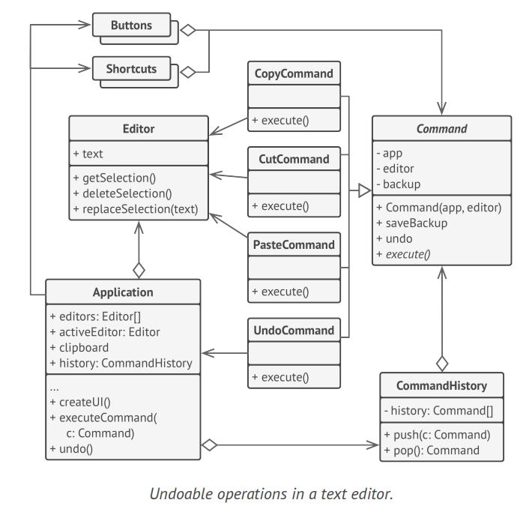
Text
Editor
Example

Slide 40
Command pattern: Final Analysis
It is easy to add new Commands, because you do not have to change existing classes
  Command is an abstract class, from which you derive new classes
  execute(), undo() and redo() are polymorphic functions
You can undo/redo any Command
  Each Command stores what it needs to restore state
You can store Commands in a stack or queue
  Command processor pattern maintains a history

Slide 41
FlyWeight Pattern

Slide 42
Flyweight Pattern
Intent
Use sharing to support a large number of fine-grained objects efficiently.
Factors the common properties of multiple instances of a class into a single object:
  Saves space and maintenance of duplicate instances.
Flyweight(fli-wat) (Dictionary meaning)
Something that is particularly small, light, or inconsequential.

Slide 43
Problem of redundant objects
Problem: existence of redundant objects can bog down any system.
  many objects have same state
  intrinsic vs. extrinsic state
Example: File objects that represent the same file on disk
    new File("mobydick.txt")
    new File("mobydick.txt")
    new File("mobydick.txt")
    ...
    new File("notes.txt")
    new File("notes.txt")

Slide 44
Intrinsic vs. Extrinsic State
Intrinsic state is stored in the Flyweight:
  It is independent of the context.
  Example: Character code, and its graphical style.
Extrinsic state depends on the context and thus it cannot be shared
  Coordinate position, character’s typographic style.

Slide 45
Intrinsic vs. Extrinsic State
Create “Flyweight” Objects for Intrinsic State
Intrinsic State:
  Information independent of the object’s context, sharable
  Instead of storing the same information n times for n objects, it is only stored once in Flyweight
Extrinsic State:
  Information dependent on the object’s context, unsharable,
  This is excluded from the Flyweight

Slide 46
CD: a
CD: b
CD: c
<<extrinsic state>> year
<<extrinsic state>> title
<<extrinsic state>> year
<<extrinsic state>> title
<<extrinsic state>> year
<<extrinsic state>> title
Sinatra: artistFlyweight
Nirvana: artistFlyweight
:artistFactory
<<intrinsic state>> artistName
<<intrinsic state>> artistName
Notes:
Suppose you are writing an application that constructs CD objects.
Whenever a CD open tag is found, create a new CD object.
Whenever title or year elements are found, enter them in the current CD.
Whenever an artist element is found, ask the artist factory to create it. This is fundamental to the problem: the CD object does not know if it is sharing this object with others; only the factory keeps track of what has been created.

Slide 47
Flyweight pattern
flyweight: Ensures that no more than one instance of a class will have identical state
  Similar to singleton, but has many instances, one for each unique-state object (object pool)
  Useful for cases when there are many instances of a type but many are the same
  Used in conjunction with Factory pattern to create a very efficient object-builder
  Examples in Java: String

Slide 48
String flyweighting
interning: Synonym for flyweighting; sharing identical instances.
  Java String objects are automatically interned (flyweighted) by the compiler whenever possible.
  If you declare two string variables that point to the same literal.
  If you concatenate two string literals to match another literal.
    String a = "neat";
    String b = "neat";
    String c = "n" + "eat";
String
n
e
a
t
String
n
e
a
t

Slide 49
Limits of String flyweight
    String a = "neat";
    Scanner console = new Scanner(System.in);
    String b = console.next(); // user types "neat"
    if (a == b) { ... // false
There are many cases where the compiler can't flyweight:
  When you build a string later out of arbitrary variables
  When you read a string from a file or stream (e.g. Scanner)
  When you build a new string from a StringBuilder
  When you explicitly ask for a new String (bypasses flyweighting)
You can force Java to flyweight a particular string with intern:
  b = b.intern();
  if (a == b) { ... // true

Slide 50
  Java Strings are flyweighted by the compiler wherever possible
  can be flyweighted at runtime with the intern method
public class StringTest {
public static void main(String[] args) {
String fly = "fly", weight = "weight";
String fly2 = "fly", weight2 = "weight";
System.out.println(fly == fly2); // true
System.out.println(weight == weight2); // true
String distinctString = fly + weight;
String flyweight = (fly + weight);
System.out.println(distinctString == flyweight); // false
String flyweight = (fly + weight).intern();
System.out.println(flyweight == "flyweight"); // true
}
}

Slide 51
Implementing a Flyweight
Flyweighting works best on immutable objects
  immutable: cannot be changed once constructed
public class Flyweighted {
  static map or table of instances
  private constructor
  static method: get-an-instance(){
    if we have created this type of instance before, get it from map and return it
    otherwise, make the new instance, store and return it}
}

Slide 52
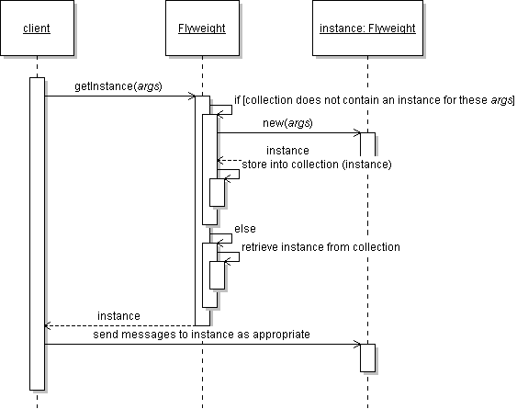
Flyweight sequence diagram

Slide 53
Implementing a Flyweight
public class Flyweighted {
Map or table of instances
private Flyweighted() {}
public static synchronized Flyweighted getInstance(Object key) {
if (!myInstances.contains(key)) {
Flyweighted fw = new Flyweighted(key);
myInstances.put(key, fw);
return fw;
} else
return (Flyweighted)myInstances.get(key); }
}

Slide 54
Class before flyweighting
public class Point {
private int x, y;
public Point(int x, int y) {
this.x = x; this.y = y;
}
public int getX() { return this.x; }
public int getY() { return this.y; }
public String toString() {
return "(" + this.x + ", " + this.y + ")"; }
}

Slide 55
Class after flyweighting
public class Point {
private static Map instances = new HashMap();
public static Point getInstance(int x, int y) {
String key = x + ", " + y;
if (instances.containsKey(key)) //reuse existing pt
return (Point)instances.get(key);
else{
Point p = new Point(x, y);
instances.put(key, p);
return p;}
}
private final int x, y; // immutable
private Point(int x, int y) {
...

Slide 56


Efficiency
f(g):
  reduction in number of instances
  amount of intrinsic state
  storage
Savings
Number of Objects Shared
  A document uses about 100 character objects (the ASII set)
100 Chars shared in 8,000 char document
100 Chars shared in 200,000 char document

Slide 57
Flyweight Class Model
Client
Flyweight
1..n
FlyweightFactory
getFlyweight(Characteristic)
Flyweight
doAction(Context)
static method
ConcreteFlyweight
doAction(Context)
singleton

Slide 58
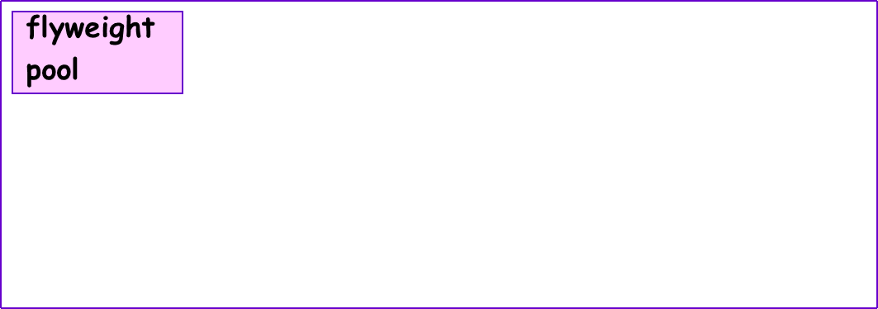
Flyweight Pattern
aClient
aClient
aFlyweightFactory
aConcreteFlyweight
aConcreteFlyweight
intrinsicState
intrinsicState
flyweights

Slide 59
Flyweight Pattern
Participants
Flyweight (Glyph) – declares an interface through which flyweights can receive and act on extrinsic state.
ConcreteFlyweight (Character) – implements the Flyweight interface and adds storage for intrinsic state. It must be sharable and any stored state must be independent of the flyweight’s context.
UnsharedConcreteFlyweight (Row, Column) – not all Flyweight subclasses need to be shared. The Flyweight interface enables sharing; it doesn’t enforce it. It’s common for UnsharedConcreteFlyweight objects to have ConcreteFlyweight objects as children at some level of the flyweight object structure.
FlyweightFactory – creates and manages flyweight objects. When a client requests a flyweight object, the factory supplies an existing flyweight object if one exists and creates one if it doesn’t.
Client – maintains a reference to flyweights and computes or stores their extrinsic state.

Slide 60
:Client
:FlyweightFactory
flyweight
:Flyweight
getFlyweight()
flyweight
Get context
. . . .
doAction( context )

Slide 61
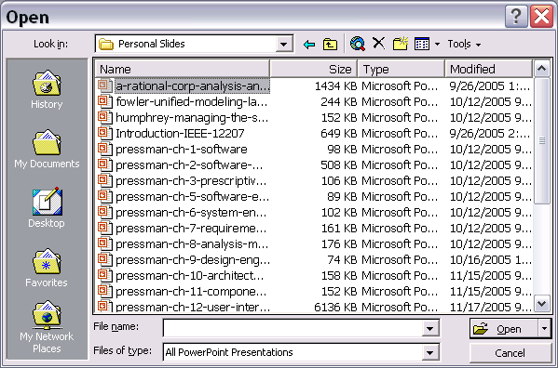
Example: Window size of 15; folder contains over 500 items
Each line item had a drawing window associated with it
We want to avoid proliferating an object for every item to be displayed.

Slide 62
Flyweight Example: Document Editor
An Object Oriented Document editor implementation:
  Usually objects representing each character.
Even a moderate sized Document may need lots of character objects.
The Flyweight pattern helps to share objects and yet allow their use at fine granularities.

Slide 63
Why are Characters Objects?
Using an object for each character in the document:
  Gives flexibility
  Characters and embedded elements could be treated uniformly with respect to how they are drawn and formatted
  The application could be extended to support new character sets without disturbing other functionality
  The application’s object structure could mimic the document’s physical structure

Slide 64
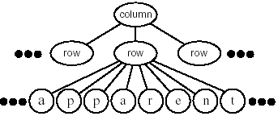
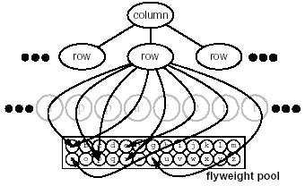
logically: physically:
Creating a flyweight for each letter of the
alphabet:
  Intrinsic state: a character code
  Extrinsic state: coordinate position in the document
        typographic style (font, color)
        Determined from the text layout algorithms and formatting commands in effect wherever the character appears

Slide 65
Consequences
“Flyweights” Must Separate Intrinsic/Extrinsic states:
  “Flyweight” Representing a Node in a Graph Cannot Point to Parent (Parent must be Passed)
“Flyweights” Save Space
  More Intrinsic State Yields More Savings
“Flyweights” May Introduce CPU Costs
  Finding “Flyweights” (Large Pool Increases cost)
  Computing Extrinsic State (Previously Stored)
  Transferring the Extrinsic information

Slide 66
Flyweight – Implementation
Removing Extrinsic State
  The pattern’s applicability is determined largely by how easy it is to identify the extrinsic state and remove it from shared objects.
Managing Shared Objects
  Clients shouldn’t instantiate the objects directly. Flyweight factory uses an associative store to locate existing objects.
  Reference counting and Garbage Collection may be needed if an object is no longer in use. This is not necessary if the number of objects is fixed and small.

Slide 67
Benefits and Consequences
+
-
If the size of the set of objects used is substantially smaller than the number of times the object is logically used
  There may be an opportunity for a considerable cost benefit
Overhead
  computation
When Not To Use Flyweight:
If the extrinsic properties have a large amount of state information that would need passed to the flyweight (overhead)
When To Use Flyweight:
There is a need for many objects to exist that share some intrinsic, unchanging information

